Slide 1
Smart Alert

Slide 2
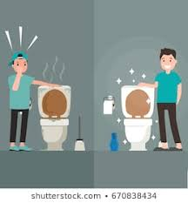
Problem: Inefficiency in keeping the washrooms clean.
Solution: Using IoT to monitor the cleanliness and regulate the cleaning schedules.

Slide 3
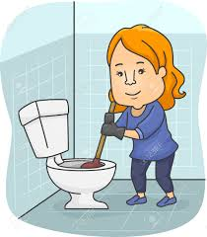
Existing Solution
Manual Scheduled based cleaning .

Slide 4
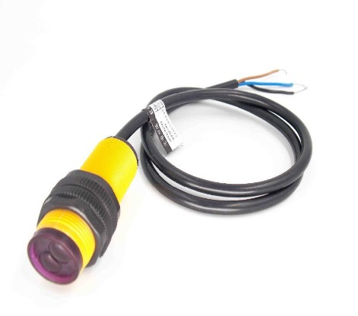
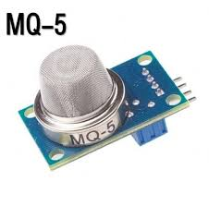

Product Working
The product first starts with the step of identifying the extent of dirtiness in the washroom. To identify this we use 3 criteria:
Person count : Photo sensor for detecting number of uses.
Smell criteria: Gas sensors for detecting the Gas level.
Time Criteria: Timely scheduling is automated.

Slide 5
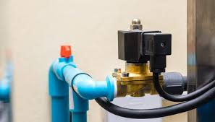
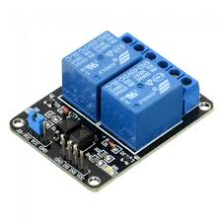
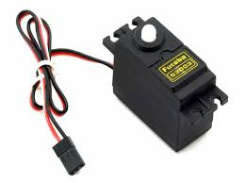
Step 2
The Pre-cleaning measures include:
Flush mechanism: Solenoid
Room Freshening spray: Servo Motor
Exhaust fans control: Relays

Slide 6
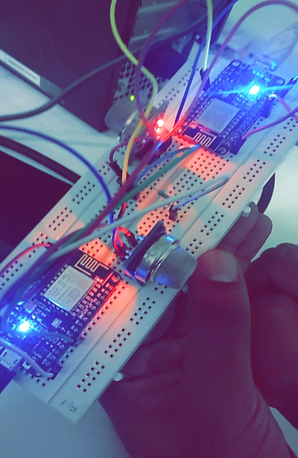
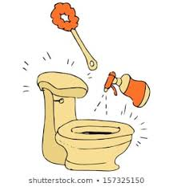
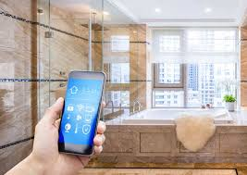

Slide 7
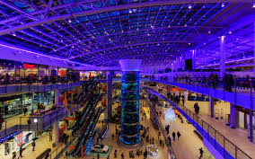
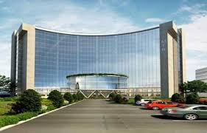

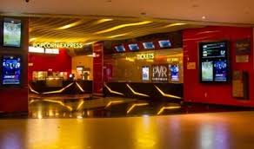
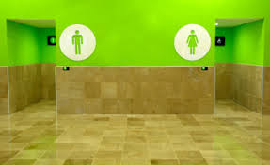
MARKET
Our Customers: Firms which have high number of visitors are the potential customers of our product.
Example: Hospitals, Software park, Malls, Movie theaters and Public toilets.

Slide 8

Market
Growth of 60% increase in the Customers we are going to initially have. As this is a solution which supports Smart Cities, we can expect a great growth in the sales.
address a minimum of 5 Firms

Slide 9
Marketing strategies
Major cities like Hyderabad, Bangalore, Mumbai, Delhi, Kolkata, Chennai, Pune are the target areas for our product.
Conducting survey for data.
Verifying Market requirement.
.

Slide 10
REVENUE MODEL
Revenue Resources
Profits will be the main revenue in case of the success of product.
We can expect low revenue in case of less sales but still the cost of production is very low compared to profits.
Price of Product
Price of the product is 4150 rs.

Slide 11
Financials
particulars | price
Manufacturing cost | 3800
Selling price | 4150
Profit/unit | 350
No of units sold | 1000
Total revenue | 4150000
Manufacturing expenses | 3800000
Advertising expenses | 10,00,000
profit | (-)650000
Breakeven period | 14 months

Slide 12
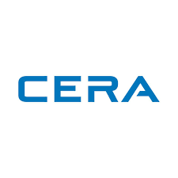

COMPETITION
Companies which manufacture sanitary ware.
Ex : CERA which provides automatic flush mechanism.

Slide 13
Q & A
Q. What are the components required to build the product?
Ans. Two Node MCU Microcontrollers, photo Sensor, MQ- 136,135, MQ-5 sensors, solenoid, servo motor, Room freshening spray, Raw materials.
Q. What are the benefits of using this product over the other products available in market?
Ans. This product provides realtime monitoring and upto date alerting system which the products available in the market lack. In addition to this, the flush and spray mechanism are remotely operable from the application itself .

